Slide 1

20 May 2025
Presenters
Chaired By
Shantanu Mukherjee
Director
UN DESA Economic Analysis and Policy Division
Richard W. Evans Senior Research Fellow and Director of Open Policy Center for Growth and Opportunity Utah State University | Marcelo T. LaFleur Senior Economic Affairs Officer UN DESA/EAPD Development Research Branch
OG for EAPD: Simulations for Analysis and Policy

Slide 2
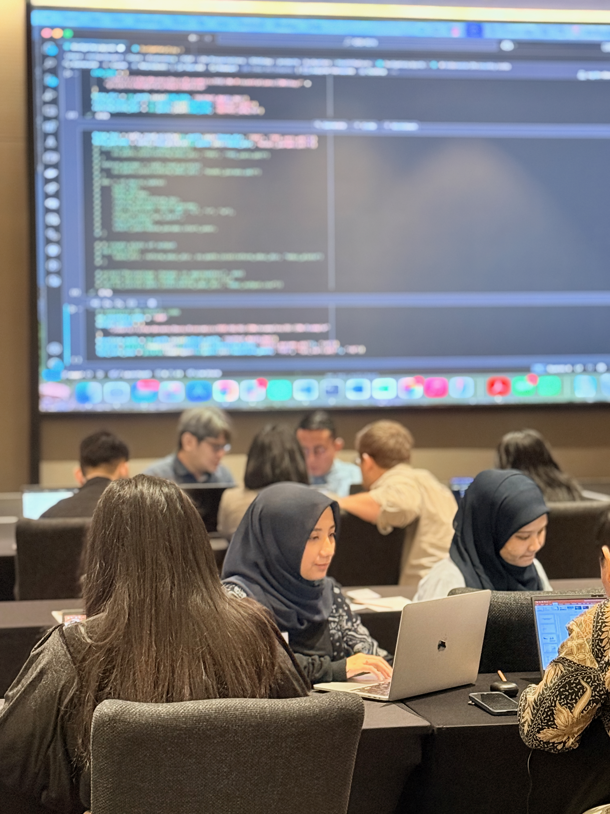
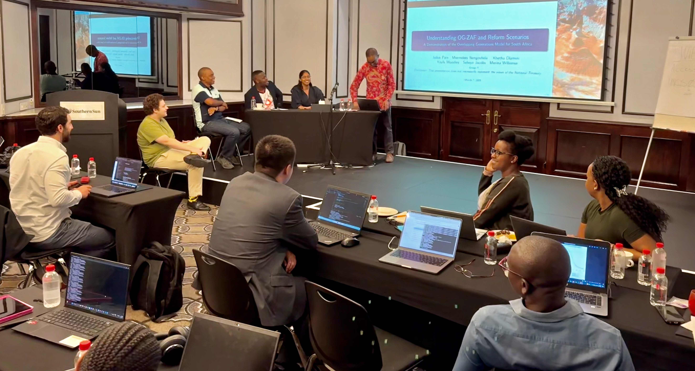
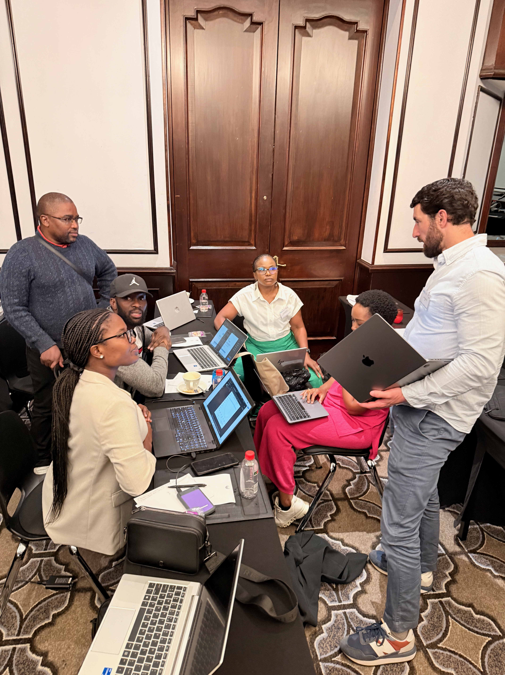
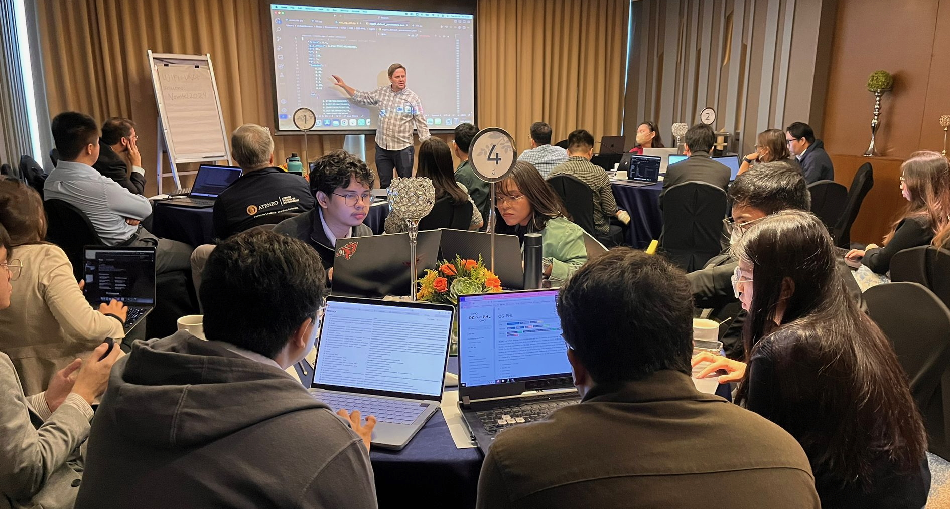
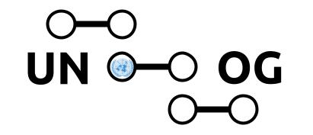
The OG Model in practice: informing long-term fiscal and structural policy through simulation
Use cases from the Philippines, South Africa, and Indonesia
Marcelo T. LaFleur (EAPD/DRB)

Slide 3
What Can the OG Model Help Us Answer?
Types of Questions the Model Can Tackle
What are the long-run impacts of different fiscal policy paths—such as reallocating spending between infrastructure, education, and transfers?
How do tax reforms affect inequality, labor supply, savings, and investment across income groups and generations?
What are the intergenerational effects of pension reforms, health financing strategies, and public debt?
How do investments in public goods (e.g., education, infrastructure, digitalization) translate into long-term growth, productivity, and inclusion?
What are the macroeconomic and distributional consequences of shocks or structural transitions—such as climate disasters, demographic shifts, or technological changes?
How can countries design fiscally sustainable development strategies in the face of rising debt, aging populations, or volatility in capital flows?

Slide 4
Policy Simulations – Philippines
Capital Gains & VAT Reform
Simulated reduction in capital gains tax (6% → 5%) and VAT (12% → 10%)
Climate Disaster Shock
Modeled long-run effects of a 100-year typhoon, including changes in productivity and labor disutility
Digitalization Scenario
Simulated a 5% increase in labor productivity from broadband expansion and telecom reforms
Infrastructure Investment
Assessed macro and fiscal effects of raising infrastructure spending to 5.6% of GDP
Pension Reform
Evaluated impact of lowering public retirement age from 60 to 56 on savings, consumption, and labor supply

Slide 5
Policy Simulations – South Africa
Youth Education Investment
Increased government spending on youth education to 7.1% of total expenditure and raised youth labor force participation, with a focus on low-income groups.
Capital Inflows Scenario
Simulated a surge in foreign capital inflows following improved investor sentiment, including both public and private investment channels.
VAT Reform
Increased the value-added tax (VAT) rate from 15% to 17%, under two scenarios: one with constant government spending and another with proportional spending increases.
Resolving Load Shedding
Simulated the elimination of electricity supply disruptions and restoration of stable power generation, leading to a sustained improvement in productivity.
Fiscal Consolidation Strategy
Simulated a multi-year fiscal adjustment combining gradual VAT increases and reductions in government spending to stabilize public debt.

Slide 6
Policy Simulations – Indonesia
Budget Reallocation to Education and Health
Simulated a shift in public spending by increasing allocations to education (by 0.5% of GDP) and health (by 2.5% of GDP), assessing long-run impacts on labor supply and macroeconomic indicators .
Pension Reform
Simulated a gradual increase in the retirement age from 59 to 65 and an increase in the pension contribution rate from 1.5% to 4.5%, reflecting planned policy reforms.
Corporate Income Tax Reform
Simulated a change in the corporate income tax threshold that removed preferential treatment for small firms, increasing their effective tax rates while maintaining current rates for large firms .
Infrastructure and Free Meals Programs
Simulated public investment in a 3-million house construction initiative and a sovereign wealth fund allocation, along with targeted spending on a free nutritious meals program (0.8% of GDP) over five years .
Free University Tuition
Simulated an increase in government spending on tertiary education by 0.13% of GDP and a 4% improvement in labor productivity, phased in over five years .
Energy Tax Reform
Simulated the introduction of energy taxes on fossil fuels to reduce carbon emissions and generate public revenue, evaluating macroeconomic and distributional impacts .
VAT Reform
Simulated an increase in the VAT rate to assess its effect on consumption and fiscal balance.

Slide 7
Value of the OG Model for EAPD
Supports structured, transparent simulations grounded in sound economic theory
Enables integrated assessment of policy trade-offs across economic and social dimensions
Captures both distributional and intergenerational dynamics often missed by other modeling tools
Provides long-term transition paths, not just end-state outcomes
Can be adapted for different policy domains using open data and open-source tools

Slide 8
The OG Model in practice: informing long-term fiscal and structural policy through simulation
Use cases from the Philippines, South Africa, and Indonesia
Marcelo T. LaFleur (EAPD/DRB)

